Slide 1
Chapter 2: Analyzing Transactions
Financial & Managerial Accounting, 16e

Slide 2
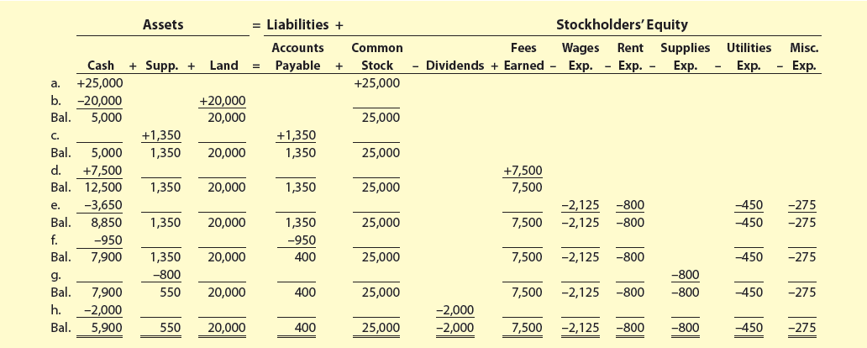
Exhibit 1 – NetSolutions’ November Transactions

Slide 3
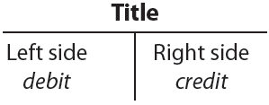
Using Accounts to Record Transactions
The account form that follows is called a T account because it resembles the letter T.
The left side of the account is called the debit side, and the right side is called the credit side.

Slide 4
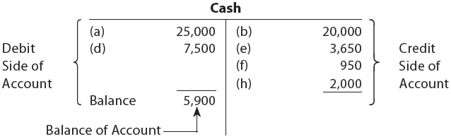
Using Accounts to Record Transactions
The amounts shown in the Cash column of Exhibit 1 would be recorded in a cash account as follows:

Slide 5
Chart of Accounts
A group of accounts for a business entity is called a ledger.
A list of the accounts in the ledger is called a chart of accounts.
The accounts are normally listed in the order in which they appear in the financial statements.

Slide 6
Exhibit 2 – Chart of Accounts for NetSolutions
Balance Sheet Accounts | Income Statement Accounts
1. Assets 11 Cash 12 Accounts Receivable 14 Supplies 15 Prepaid Insurance 17 Land 18 Office Equipment 2. Liabilities 21 Accounts Payable 23 Unearned Rent 3. Stockholders’ Equity 31 Common Stock 32 Retained Earnings 33 Dividends | 4. Revenue 41 Fees Earned 5. Expenses 51 Wages Expense 52 Supplies Expense 53 Rent Expense 54 Utilities Expense 59 Miscellaneous Expense
Notes:
A chart of accounts should meet the needs of a company’s managers and other users of its financial statements.
The accounts within the chart of accounts are numbered for use as references.
A numbering system is normally used, so that new accounts can be added without affecting other account numbers.

Slide 7
Knowledge Check Activity 1
Which of the following would be considered an asset in a company’s chart of accounts?
Accounts Payable
Factory Equipment
Travel Expense
Revenue

Slide 8
Knowledge Check Activity 1: Answer
Which of the following would be considered an asset in a company’s chart of accounts?
Answer: b. Factory Equipment
Factory Equipment is a resource owned by business entity.

Slide 9
Double-Entry Accounting System
All businesses use what is called the double-entry accounting system.
Every business transaction to be recorded in at least two accounts.
The total debits recorded for each transaction to be equal to the total credits recorded.

Slide 10
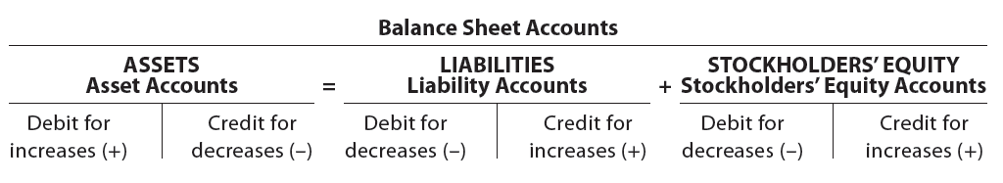
Balance Sheet Accounts
The debit and credit rules for balance sheet accounts are as follows:

Slide 11
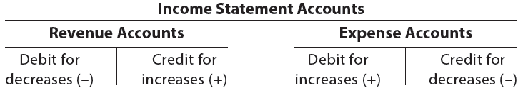
Income Statement Accounts
The debit and credit rules for income statement accounts are based on their relationship with stockholders’ equity.
The rules of debit and credit for revenue and expense accounts are as follows:

Slide 12
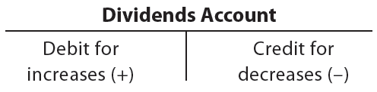
Statement of Stockholders' Equity Accounts (Dividends)
The debit and credit rules for recording dividends are based on the effect of dividends on stockholders’ equity (retained earnings).
The rules of debit and credit for the dividends account are as follows:

Slide 13
Journalizing
The process of recording a transaction in the journal is called journalizing.
The entry in the journal is called a journal entry.

Slide 14
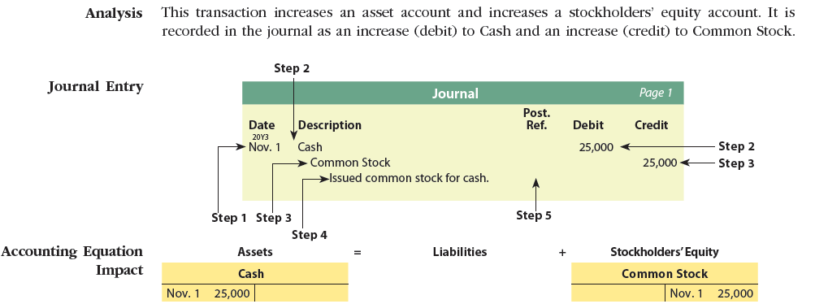
Transaction a
Nov. 1: Chris Clark deposited $25,000 in a bank account in the name of NetSolutions in exchange for common stock.

Slide 15
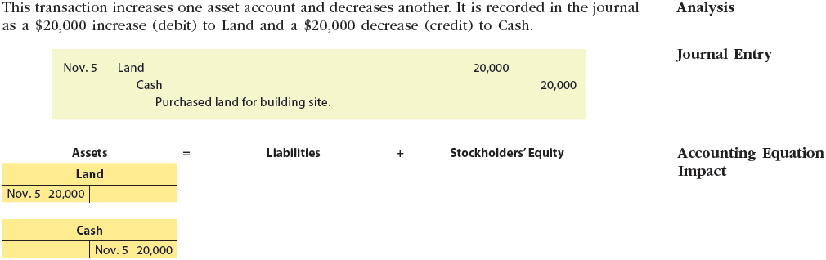
Transaction b
Nov. 5: NetSolutions paid $20,000 for the purchase of land as a future building site.

Slide 16
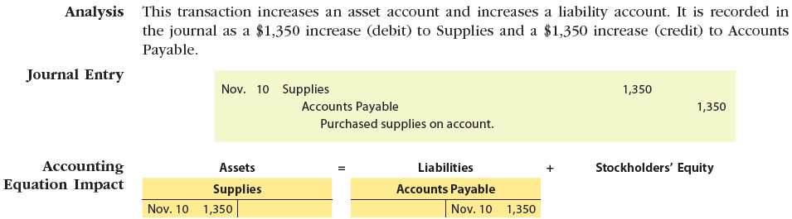
Transaction c
Nov. 10: NetSolutions purchased supplies on account for $1,350.

Slide 17
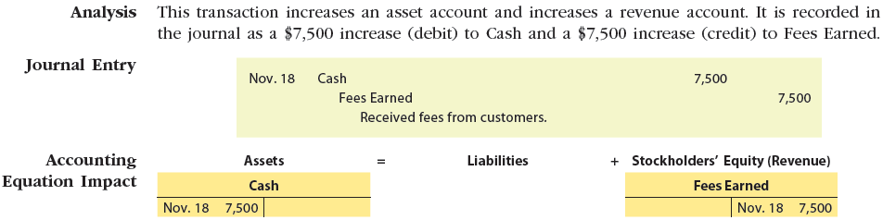
Transaction d
Nov. 18: NetSolutions received cash of $7,500 from customers for services provided.

Slide 18
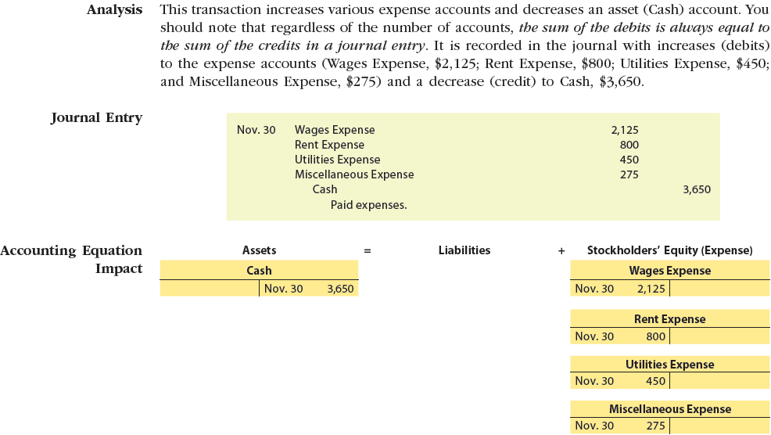
Transaction e
Nov. 30: NetSolutions incurred the following expenses: wages, $2,125; rent, $800; utilities, $450; and miscellaneous, $275.

Slide 19
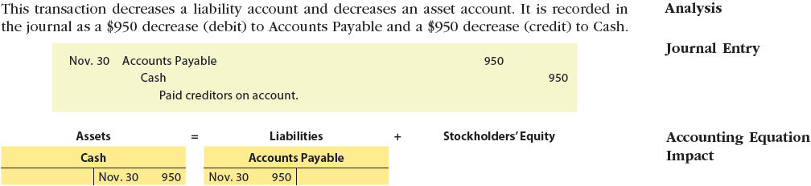
Transaction f
Nov. 30: NetSolutions paid creditors on account, $950.

Slide 20
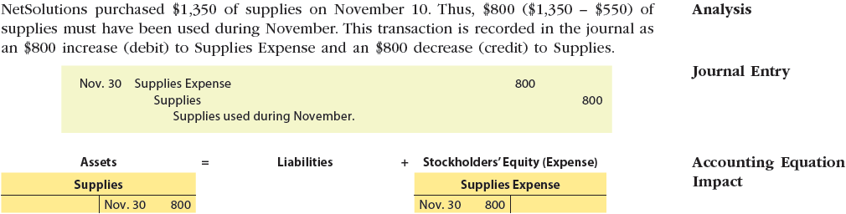
Transaction g
Nov. 30: NetSolutions determined that the cost of supplies on hand at November 30 was $550.

Slide 21
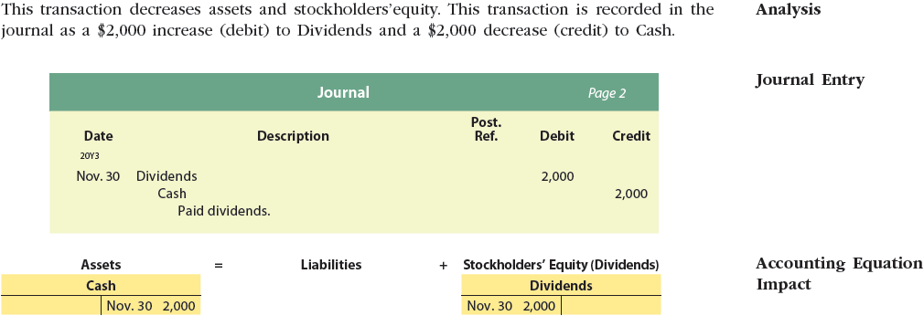
Transaction h
Nov. 30: Paid dividends, $2,000.

Slide 22
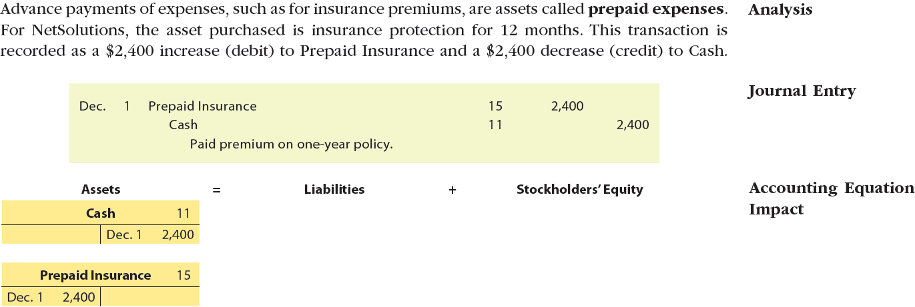
Transaction 1
NetSolutions paid a premium of $2,400 for an insurance policy for liability, theft, and fire. The policy covers a one-year period.

Slide 23
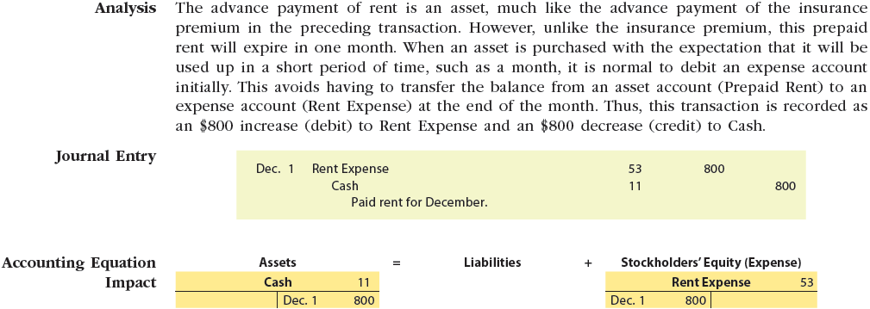
Transaction 2
Dec. 1: NetSolutions paid rent for December, $800.
The company from which NetSolutions is renting its office space now requires the payment of rent on the first of each month, rather than at the end of the month.

Slide 24
Transaction 3 (1 of 2)
Dec. 1: NetSolutions received an offer from a local retailer to rent the land purchased on November 5.
The retailer plans to use the land as a parking lot for its employees and customers.
NetSolutions agreed to rent the land to the retailer for three months, with the rent payable in advance.
NetSolutions received $360 for three months’ rent beginning December 1.

Slide 25
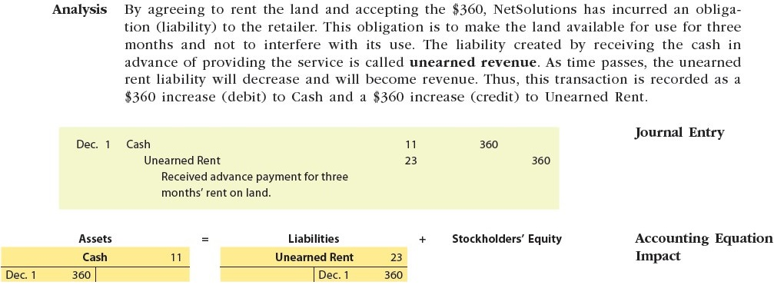
Transaction 3

Slide 26
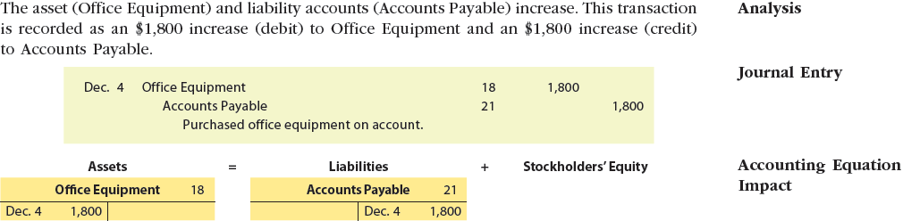
Transaction 4
Dec. 4: NetSolutions purchased office equipment on account from Executive Supply Co. for $1,800.

Slide 27
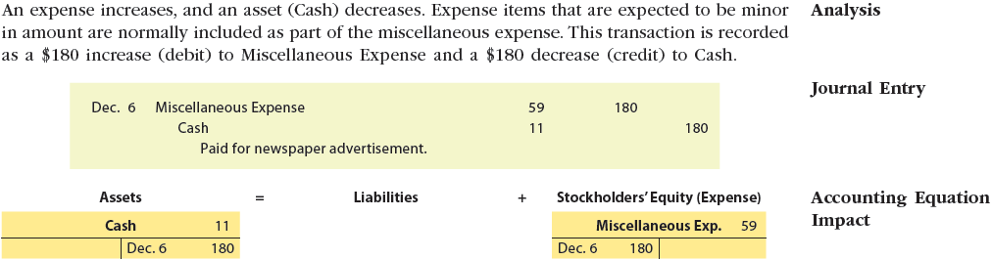
Transaction 5
Dec. 6: NetSolutions paid $180 for a newspaper advertisement.

Slide 28
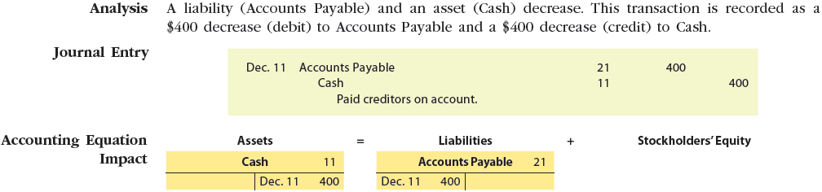
Transaction 6
Dec. 11: NetSolutions paid creditors $400.

Slide 29
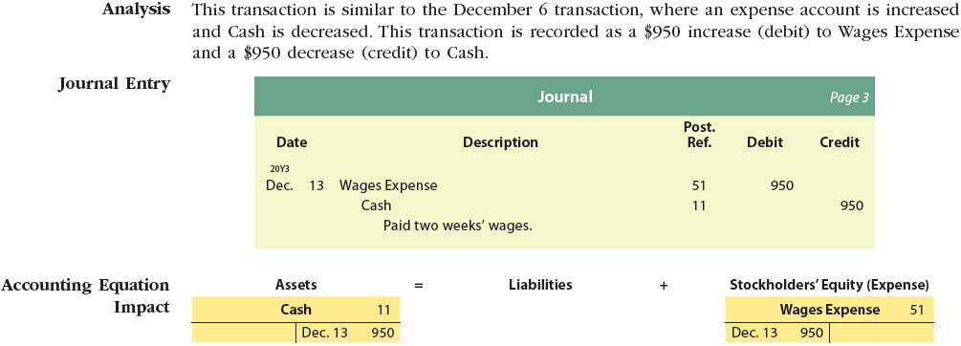
Transaction 7
Dec. 13: NetSolutions paid a receptionist and a part-time assistant $950 for two weeks’ wages.

Slide 30
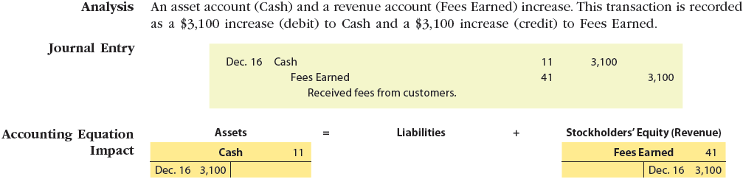
Transaction 8
Dec. 16: NetSolutions received $3,100 from fees earned for the first half of December.

Slide 31
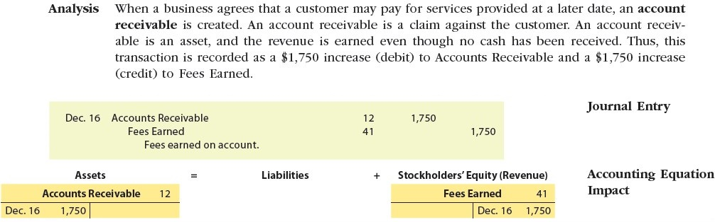
Transaction 9
Dec. 16: Fees earned on account totaled $1,750 for the first half of December.

Slide 32
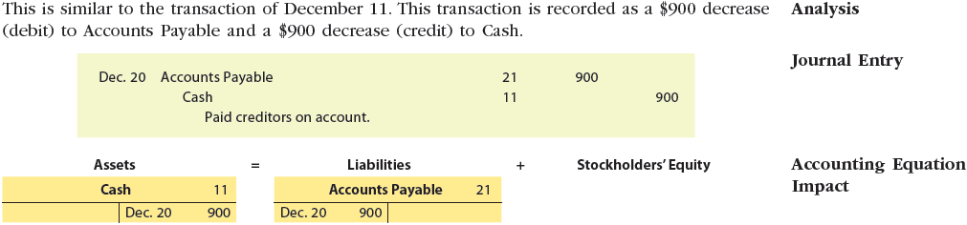
Transaction 10
Dec. 20: NetSolutions paid $900 to Executive Supply Co. on the $1,800 debt owed from the December 4 transaction.

Slide 33
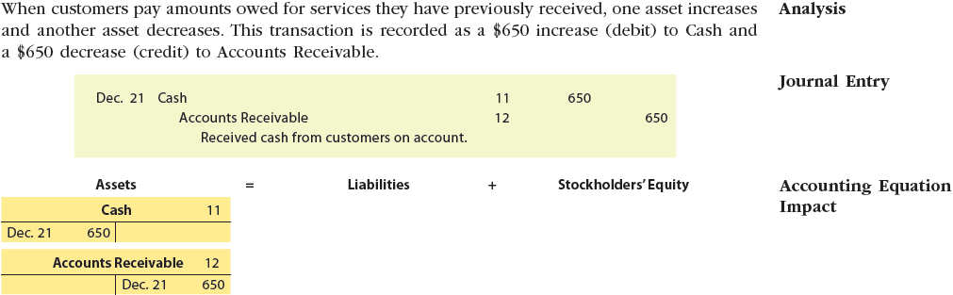
Transaction 11
Dec. 21: NetSolutions received $650 from customers in payment of their accounts.

Slide 34
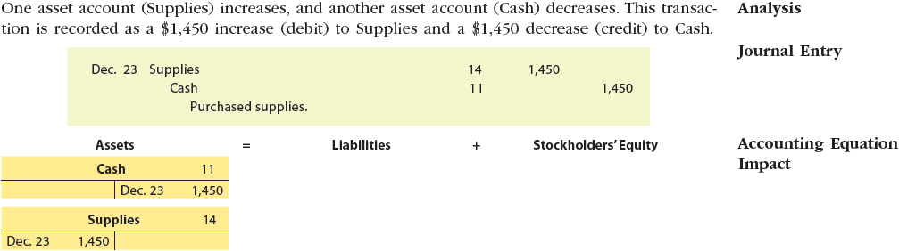
Transaction 12
Dec. 23: NetSolutions paid $1,450 for supplies.

Slide 35
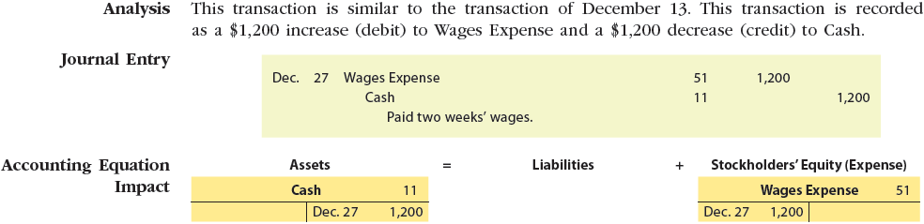
Transaction 13
Dec. 27: NetSolutions paid the receptionist and the part-time assistant $1,200 for two weeks’ wages.

Slide 36
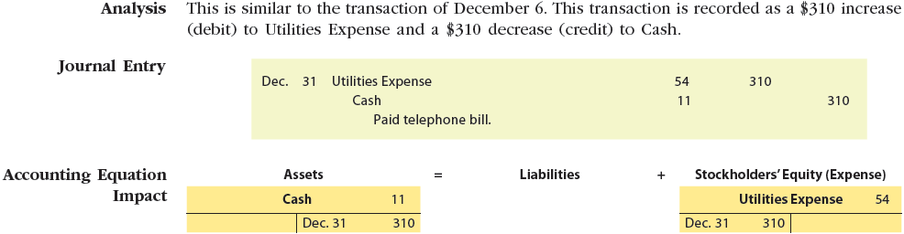
Transaction 14
Dec. 31: NetSolutions paid its $310 telephone bill for the month.

Slide 37
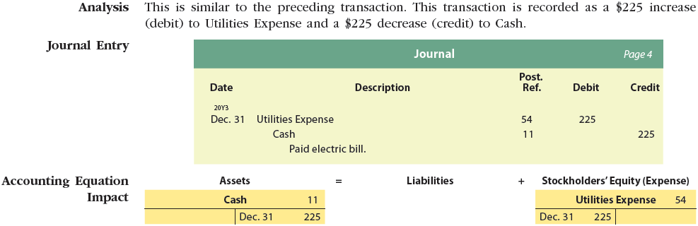
Transaction 15
Dec. 31: NetSolutions paid its $225 electric bill for the month.

Slide 38
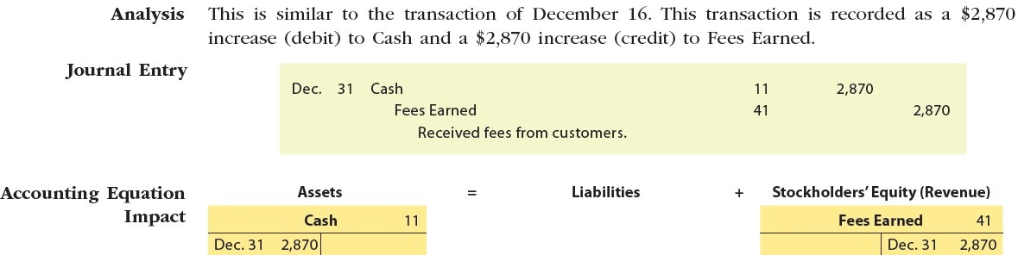
Transaction 16
Dec. 31: NetSolutions received $2,870 from fees earned for the second half of December.

Slide 39
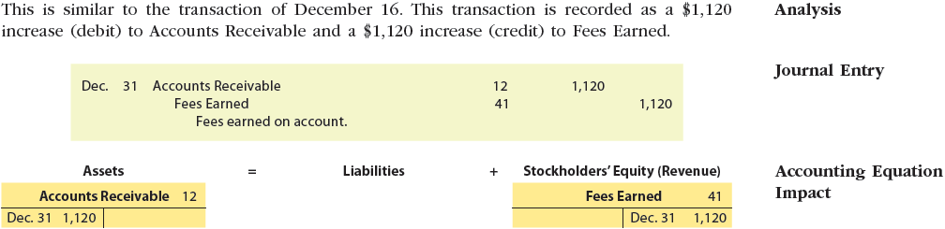
Transaction 17
Dec. 31: Fees earned on account totaled $1,120 for the second half of December.

Slide 40
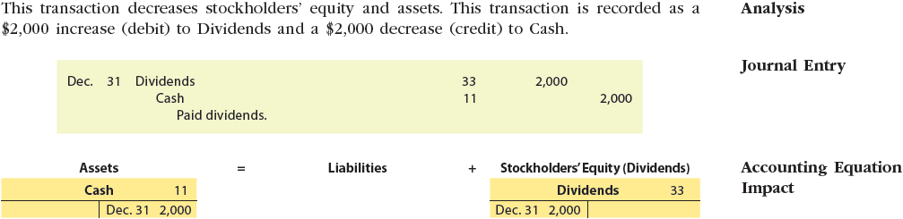
Transaction 18
Dec. 31: Paid dividends, $2,000.

Slide 41
Trial Balance
An unadjusted trial balance is distinguished from an adjusted trial balance and a post-closing trial balance. (The latter two are prepared in later chapters and include additional information.)

Slide 42
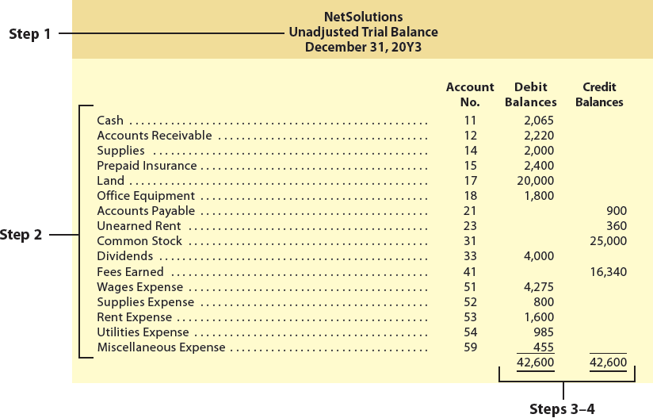
Exhibit 7 – Trial Balance

